Slide 1
WELCOME

Slide 2
Your Hosts…
Alan Cox - Amarillo, TX
Chad Coppola – Baton Rouge, LA
Jeff Downey - Oklahoma City, OK
Jeremy Krupp - Idaho Falls, ID
Chet Lytle - Albuquerque, NM
John Thomas - Kernersville, NC
Jim Waldrop - Knoxville, TN
Heather Rochefort – Blue Ridge, GA

Slide 3
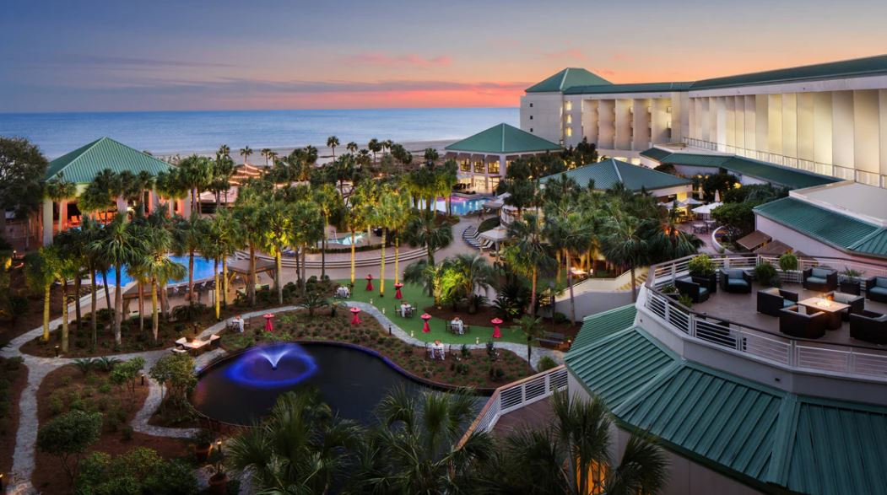
We have some new faces…

Slide 4
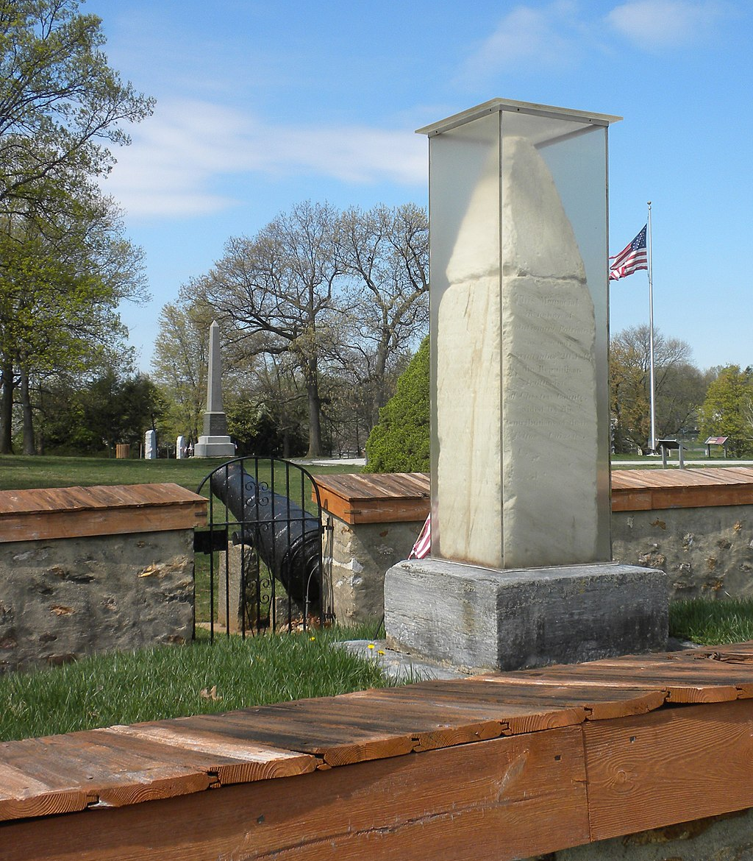
Baker Telecommunications
Don, Jessica, & Jim Baker
Paoli, PA

Slide 5
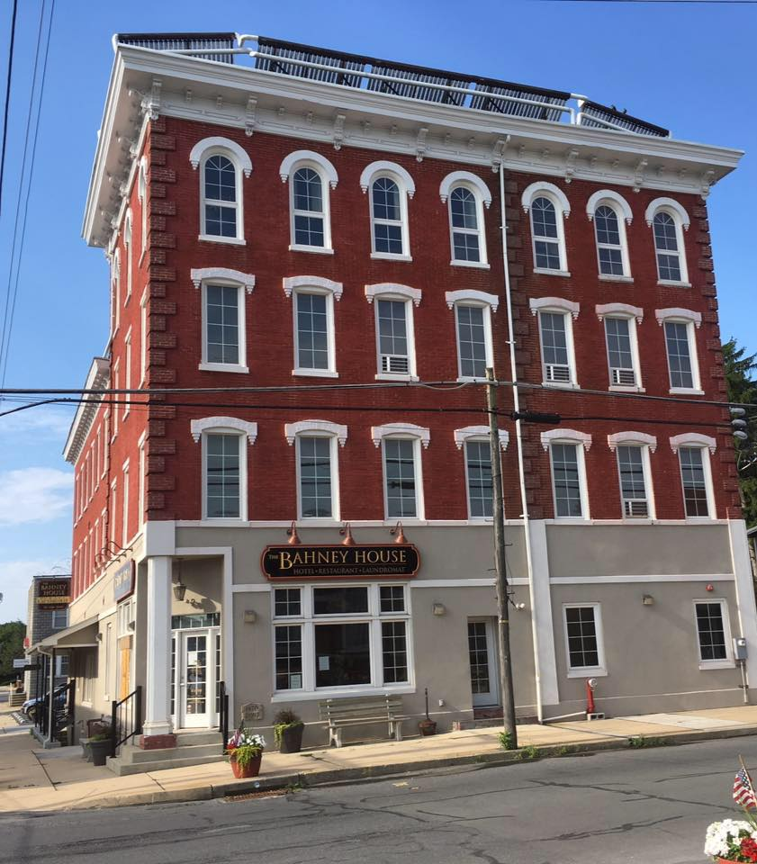
Choice Communications
Dave Breinich
Myerstown, PA

Slide 6
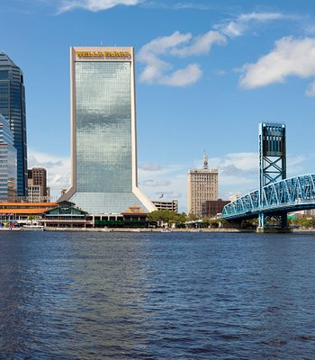
ACI Communications
Michael Santos
Jacksonville, FL

Slide 7
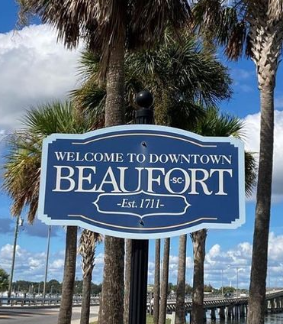
ITHS
Darren Staley
Beaufort, SC

Slide 8
Monday Agenda
Welcome: 9:00 – 9:20 AM
Keynote: Natalie Suarez - Cybersecurity: State of the Industry, Threats & Opportunities: 9:20 – 10:20 AM
Break: 10:20 – 10:40 AM
Member Only Session : Mining Our Diamonds: 10:40 – 12:00 PM
Lunch: 12:00 PM – 1:00 PM
Exhibit Hall: 12:00 PM – 5:00 PM
Grand Banquet: 6:00 PM – 8:00 PM

Slide 9
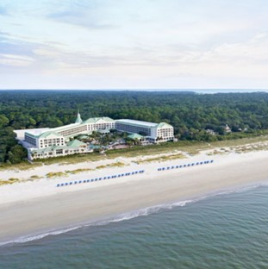
Tuesday Agenda
Vendor Awards: 9:30 – 10:00 AM
Member Only Session - Keynote: Curt Mark - The Opportunity: 10:00 – 11:00 AM
Break: 11:00 – 11:15 AM
Breakout Session 1 : 11:15 – 12:15 PM
Lunch 12:15 PM – 1:15 PM
Breakout Session 2: 1:15 – 2:15 PM
Breakout Session 3: 2:30 – 3:30 PM

Slide 10
Breakout Sessions
APPDIRECT: Introduction to AppDirect/TBI
CONNECTWISE: Security, ChatGPT, AI, and more: Practical Knowledge on Trends
HOSTMYCALLS: HostMyCalls SMS for Business
INTERMEDIA: Drive More Revenue in 2023 with Contact Center
PELCO: See More. Solve More.
PRESENCE MANAGEMENT: Next-level communications, adding Emergency Alerting to telephony systems
ZULTYS: Improving the Zultys User Experience: Mobile ZAC, Release 18, and the New Partner Portal

Slide 11
The Exhibit Hall will feature over 35 Vendors!
Thank you for your patronage!

Slide 12
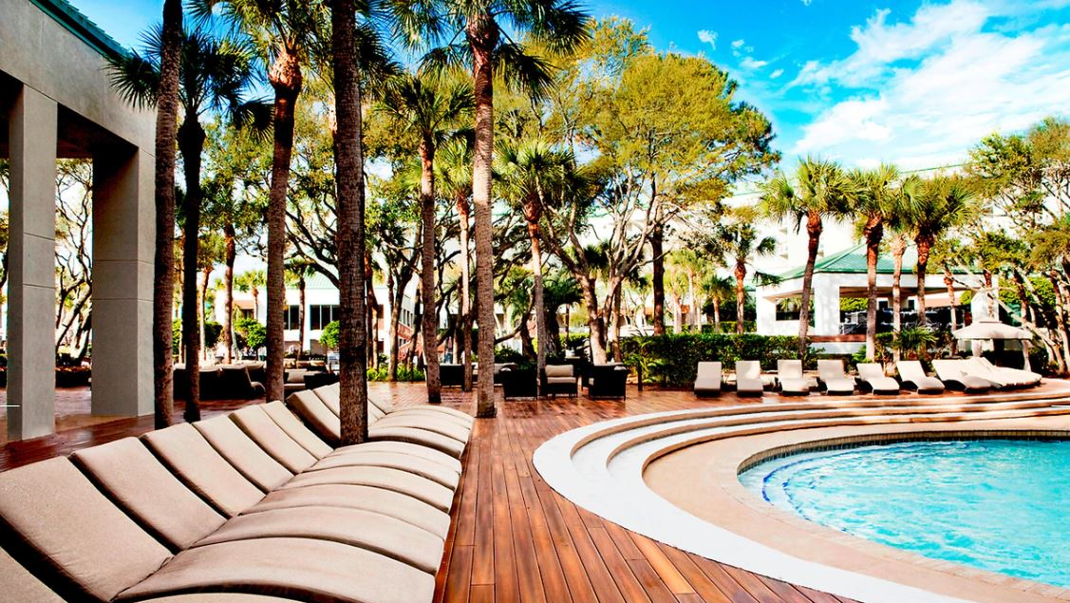
Agenda Bookmark
www.ideacom.org/agenda

Slide 13
Who wants to know where Ideacom Conference 2024 will be located?

Slide 14
The first telephone installed in this city was installed in 1907.

Slide 15
This city is considered the brightest place on earth.

Slide 16
We are thrilled to announce the location of Ideacom Conference 2024.
Mark your calendars! The 2024 conference is scheduled for April 28-30, 2024 at Caesars Palace in Las Vegas

